Slide 1



AI-Powered Robotics
Transforming Our World
Presented To:
Md Ridoy Sarkar Lecturer Department of CSE Daffodil International University
Presented By:
Nurjahan Akther Mim 221-15-4782
Abu Zahed 221-15-4716
Arnub Datta 221-15-4726
Md Amir Hamja 221-15-4784
01

Slide 2

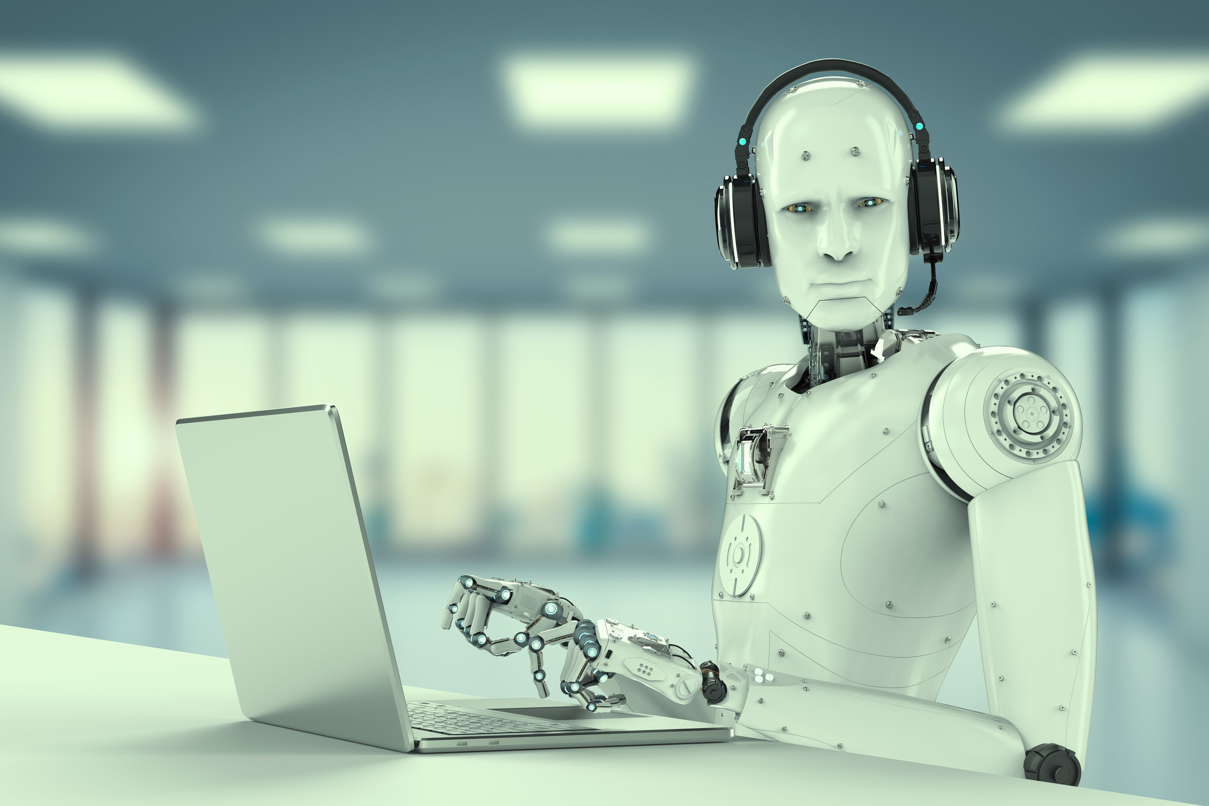

Introduction
What is AI Robotic:
AI-powered robotics combines artificial intelligence with mechanical systems, giving robots the ability to see, understand, learn, and make intelligent decision similar to a brain guiding a body.
Traditional Robots vs AI Robots:
Traditional Robots | AI Robots
Do the same task again and again | Learn from experience
Cannot change their behavior | Can make smart decisions
See very little | Understand what is around them
Follow only programmed rules | Can work alone in new situations
Learn More
02

Slide 3

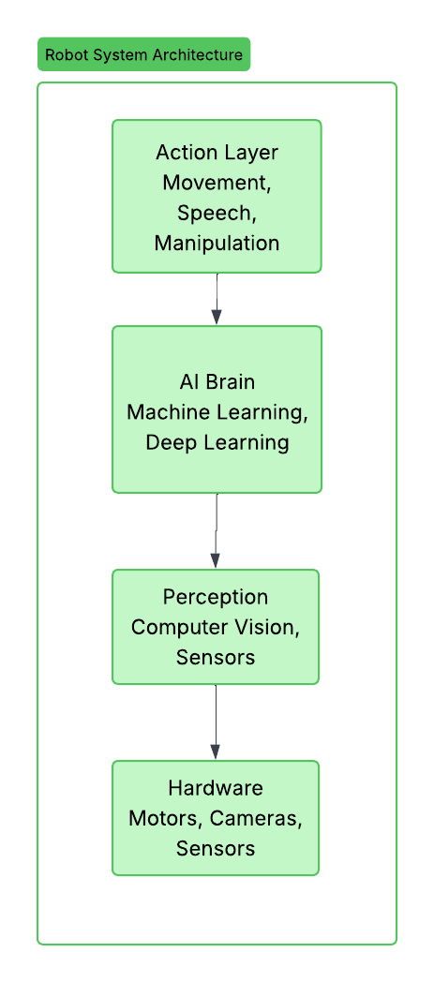


The AI-Robotics Technology Stack
🧠 Intelligence & Learning
Robots learn and improve over time.
👁️ Vision & Understanding Robots see and interpret the world.
🤝 Human Interaction Robots communicate and work with people.
🔄 Continuous Adaptation Robots adjust to new situations automatically.
03

Slide 4

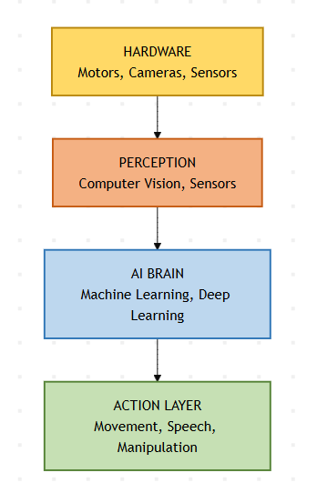


Real Applications
1. Self-Driving Cars
Detects cars, pedestrians, and road signs in real time.
2. Warehouse Robots
Recognizes packages and sorts items automatically.
3. Navigation & Mapping
Builds a live map of the environment while moving.
4. Surgical Precision
Uses 3D vision to perform delicate and accurate movements.
04

Slide 5

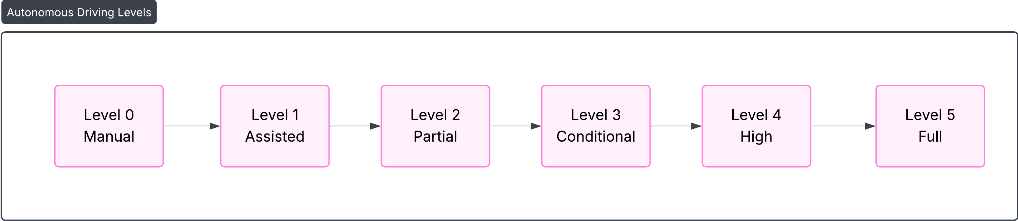
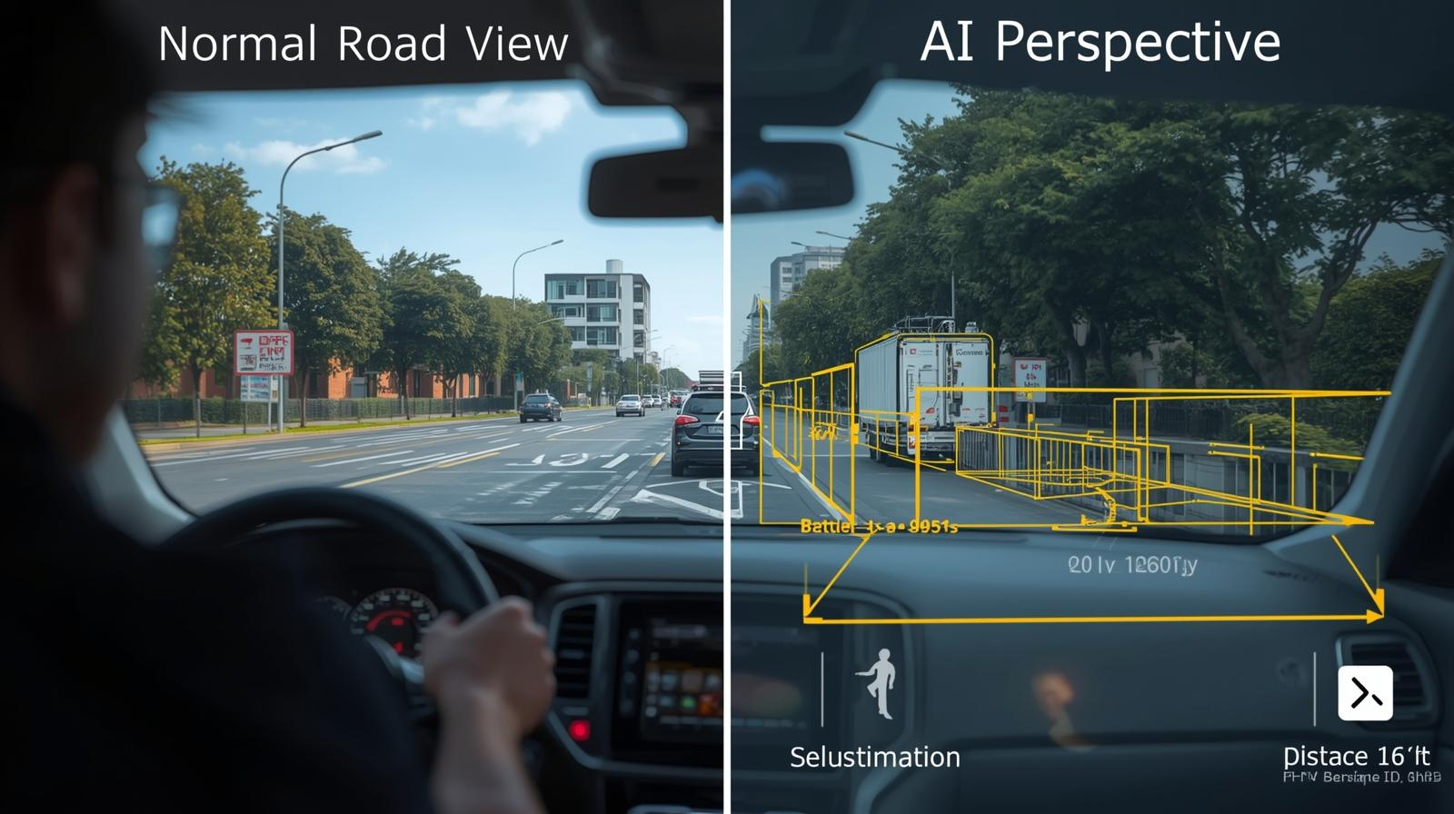


Autonomous Robots & Self-Driving Cars
Learn More
Sensor’s
8+ Cameras – 360° visual coverage
LIDAR Scanner – 3D mapping of surroundings
RADAR Sensors – Detect speed & distance in all weather
Ultrasonic Sensors – Close-range object detection
GPS – Accurate vehicle positioning
05

Slide 6


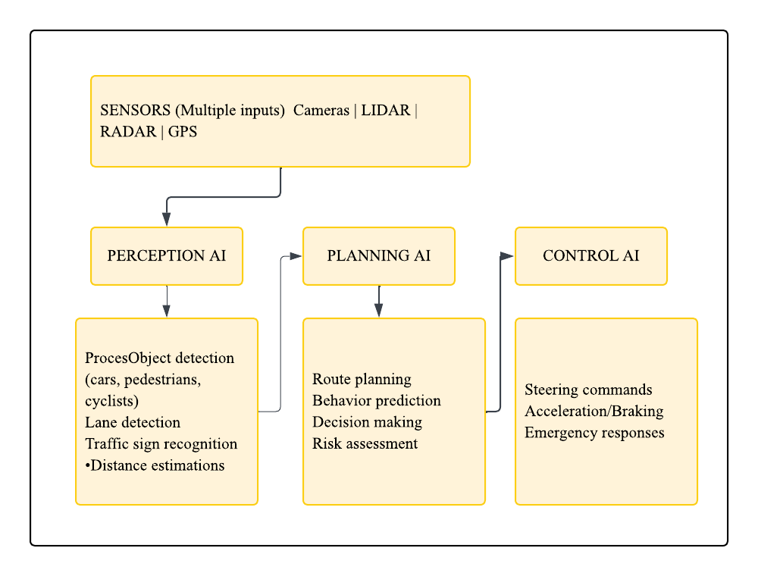


How Self-Driving AI Works
How Self-Driving AI Works
REAL EXAMPLE: Waymo Autonomous Driving
Waymo Stats :
20+ million autonomous miles driven
Operating in Phoenix, San Francisco & Los Angeles
Fully driverless robotaxi service in select areas
06

Slide 7
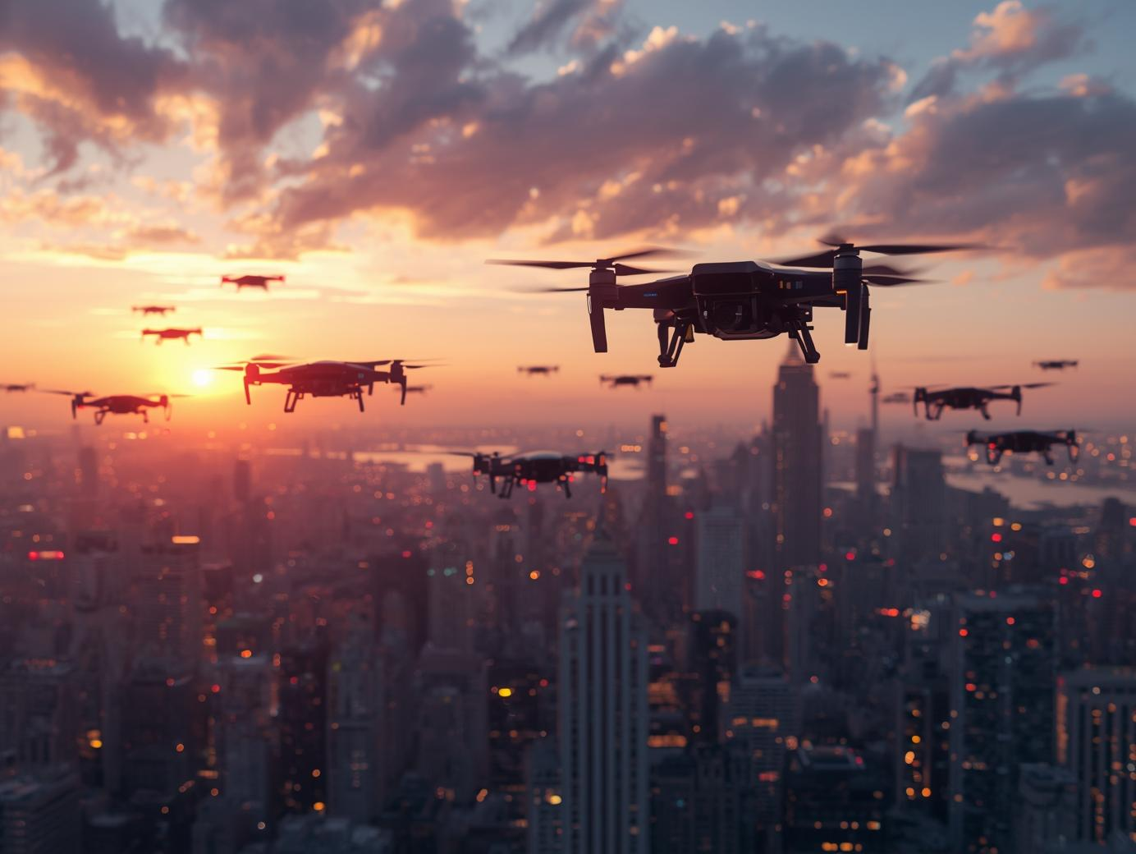

Autonomous Aerial Delivery
Obstacle Avoidance Drones detect trees, buildings, and wires to avoid collisions.
Route Optimization AI calculates the fastest and safest path to deliver items.
Precise Landing Drones use GPS + sensors to land accurately at the delivery spot.
Weather Adaptation Systems adjust flight behavior during wind, rain, or low visibility.
Obstacle Avoidance Drones detect trees, buildings, and wires to avoid collisions.
• Route Optimization AI calculates the fastest and safest path to deliver items.
• Precise Landing Drones use GPS + sensors to land accurately at the delivery spot.
• Weather Adaptation Systems adjust flight behavior during wind, rain, or low visibility.
07

Slide 8



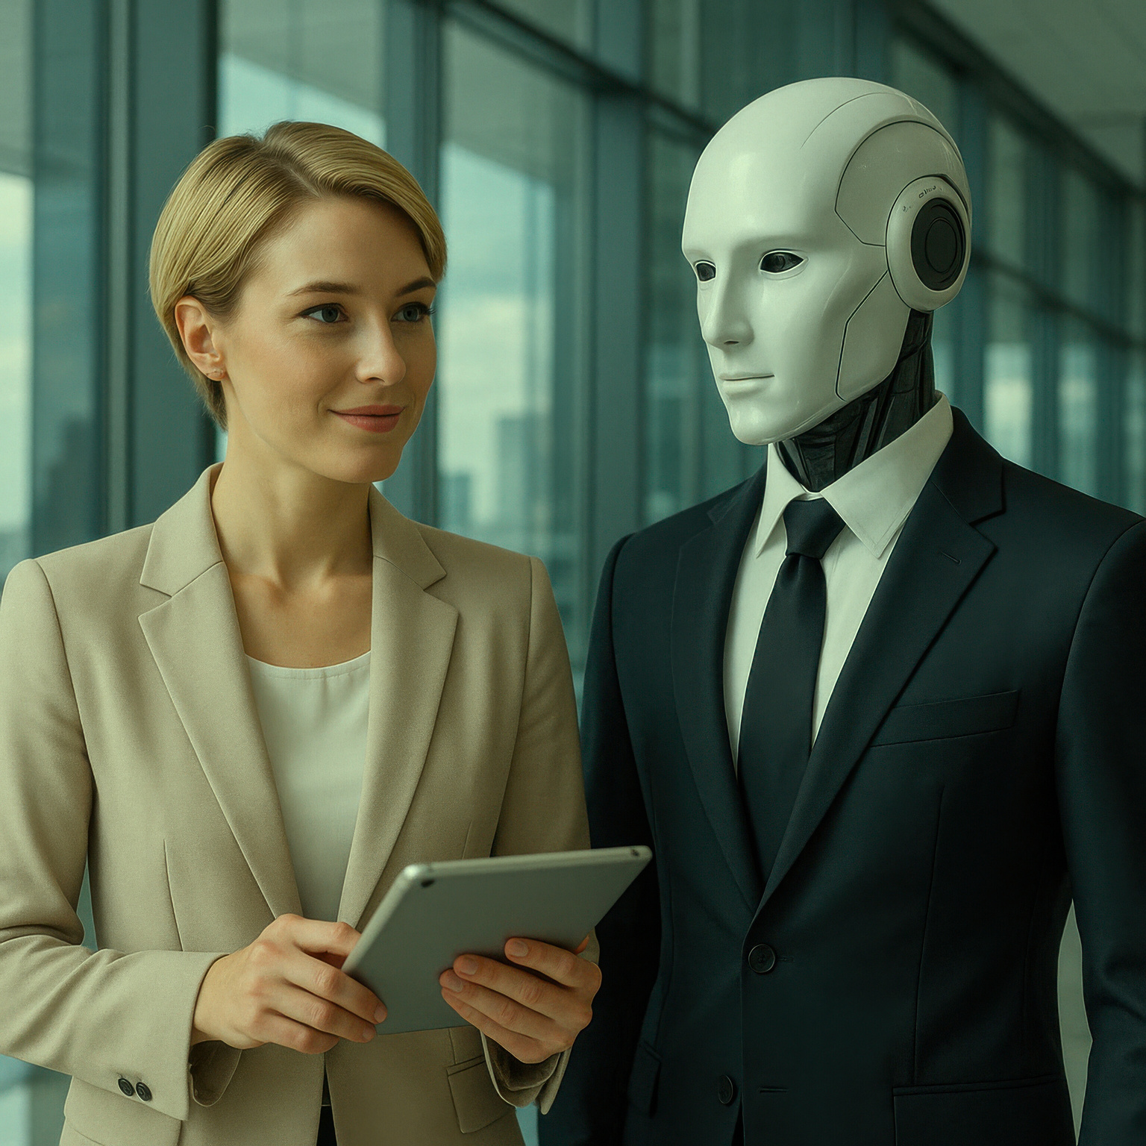

Agricultural & Specialized Autonomous Robots
Agricultural Robots
AI machines that plant, monitor crops, remove weeds, and harvest automatically.
Space Exploration Robots
Autonomous rovers that navigate Mars, avoid hazards, and conduct scientific tasks.
Underwater Robots
AI submersibles that map oceans, inspect pipelines, and support marine research.
Disaster Response Robots
Rescue robots that navigate rubble, find survivors, and assess danger zones.
08

Slide 9


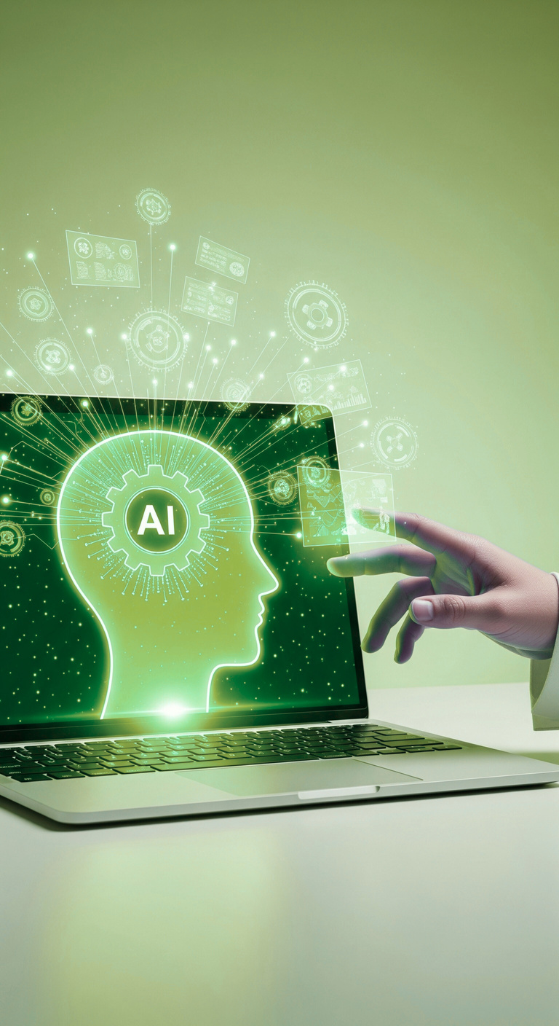
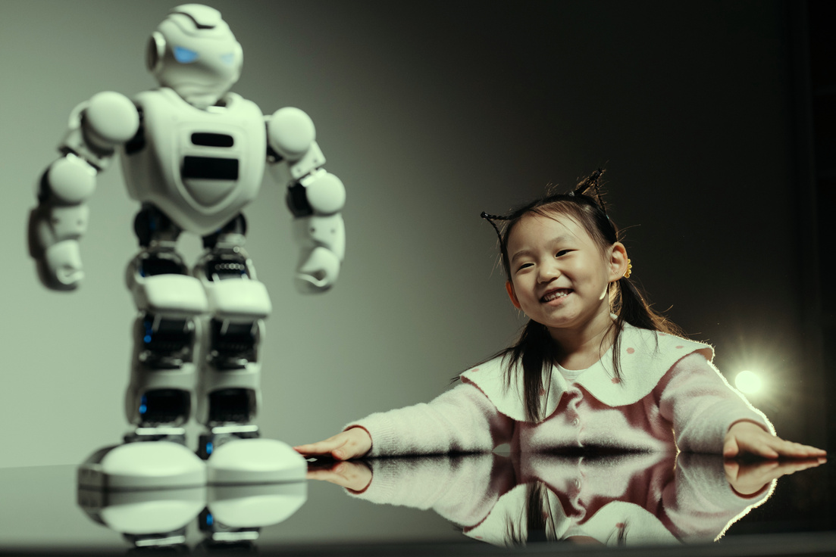



AI for Human-Robot Interaction
Efficiency
AI drives societal efficiency through smarter systems.
The Social Intelligence Stack
Speech Recognition – Understands what a human says
Natural Language Understanding (NLP) – Interprets meaning and intent
Facial Recognition – Identifies who the person is
Emotion Detection – Reads human emotions and mood
Gesture Understanding – Interprets body language and movement
Response Generation – Chooses the correct verbal or action response
Expression Control – Displays appropriate facial expressions or tone
See More
09

Slide 10


Healthcare Robots & Movement AI
AI Features:
💊 Automated medication reminders
🚨 Fall detection with instant alerts
💬 Social conversation & emotional support
📞 Emergency calling & monitoring
🎵 Cognitive engagement (music, games, interaction)
Applications:
Provides guided physical therapy
Supports stroke rehabilitation
Assists patients with paralysis
Improves gait training and walking ability
10

Slide 11
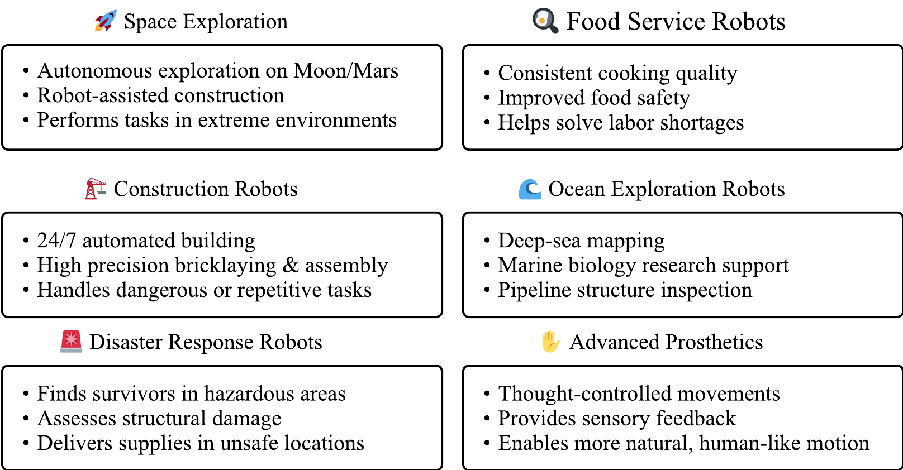
Emerging Applications & The Future
10

Slide 12
THANK YOU! 🤖
10

